Slide 1
Professional development program at NMBU
Harsha, Zakhar, Elisabeth
Workshop on Innovative practices in the EU water sector: barriers and opportunities / 08-10 May 2019
This project has been funded with support from the European Commission. This publication reflects the views only of the author, and the Commission cannot be held responsible for any use which may be made of the information contained therein.

Slide 2
Program format
International Water Summer School 2019
+
Oslo – European Green Capital 2019
+
European Water Association Conference

Slide 3
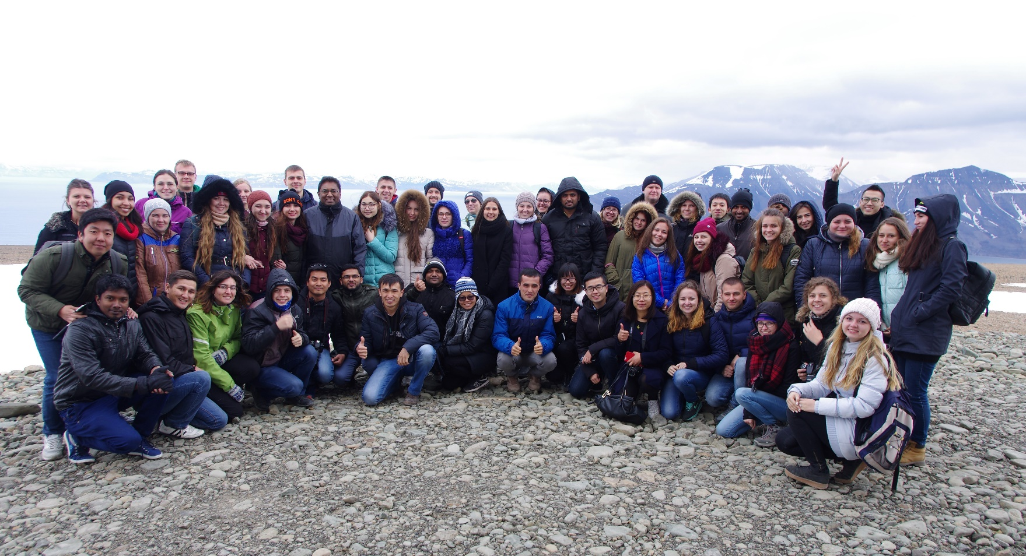
International Water Summer School – every year since 2012
IWSS 2019: 60 participants from 14 countries
Africa: South Sudan, Uganda, Kenya, Ethiopia
South Asia: Sri Lanka, Cambodia, Bangladesh
Central Asia: Tajikistan, Kazakhstan
Eastern Europe: Ukraine, Moldova, Belarus
North America: Canada, USA
Strengthening of master curricula in water resources management
for the Western Balkans HEIs and stakeholders
www.swarm.ni.ac.rs

Slide 4
Objective 1
Practices of integration of students with various backgrounds into intensive WRM & treatment course
Presentation of the Water Harmony concept
Reflective discussion – notes

Slide 5
Oslo European Green Capital 2019
Strengthening of master curricula in water resources management
for the Western Balkans HEIs and stakeholders
www.swarm.ni.ac.rs

Slide 6
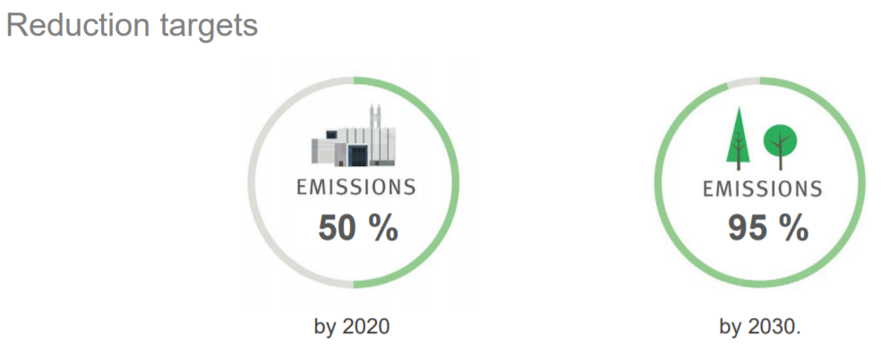
Oslo European Green Capital 2019
Strengthening of master curricula in water resources management
for the Western Balkans HEIs and stakeholders
www.swarm.ni.ac.rs

Slide 7
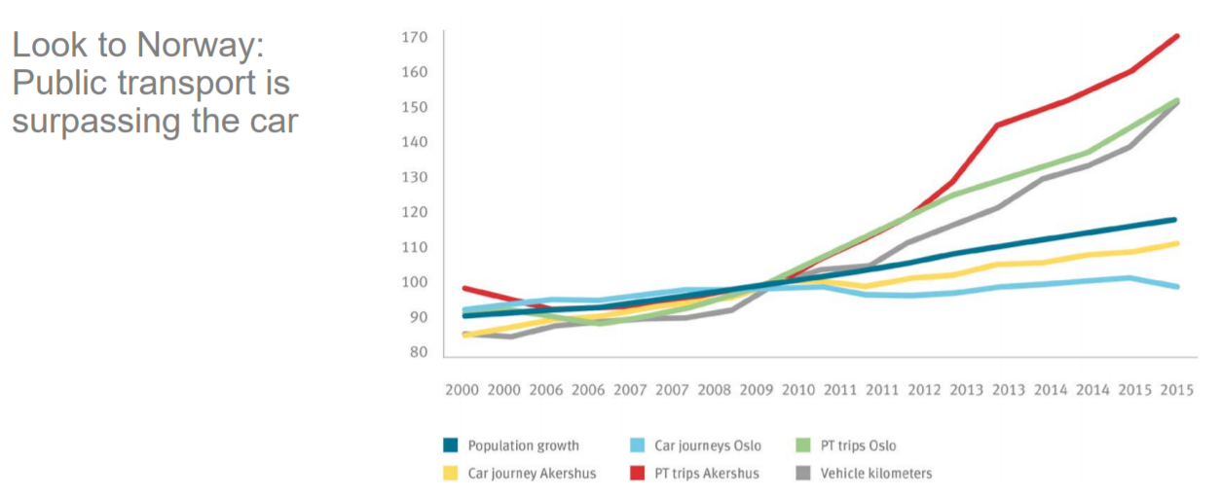
Oslo European Green Capital 2019
Strengthening of master curricula in water resources management
for the Western Balkans HEIs and stakeholders
www.swarm.ni.ac.rs

Slide 8
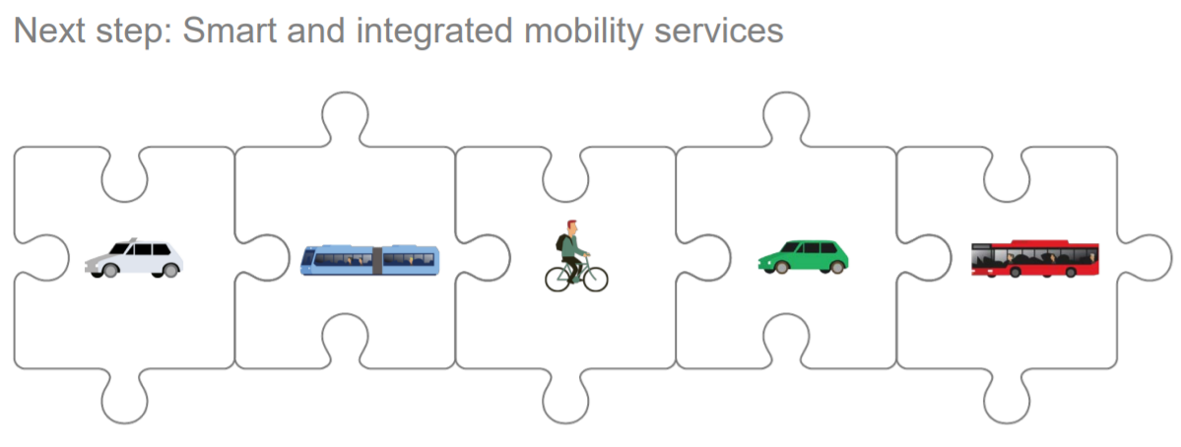
Oslo European Green Capital 2019
Strengthening of master curricula in water resources management
for the Western Balkans HEIs and stakeholders
www.swarm.ni.ac.rs

Slide 9
Oslo European Green Capital 2019
Strengthening of master curricula in water resources management
for the Western Balkans HEIs and stakeholders
www.swarm.ni.ac.rs

Slide 10
EWA Sustainable Urban Drainage Solutions (SUDS)
17 June – Seminar
Session 1: Holistic approaches
Sustainable urban hydrological systems in Sarajevo
Prof Emina Hadžić, University of Sarajevo, Bosnia and Herzegovina
Session 2: Management of stormwater
Session 3: Pollution management from Storm Water
Reception at the Oslo City Hall
Strengthening of master curricula in water resources management
for the Western Balkans HEIs and stakeholders
www.swarm.ni.ac.rs

Slide 11
Objective 2
Innovations & collaborations
3 new things that are innovative for your country
3 new contacts that can be useful for future
Collaborative online writing of the report

Slide 12
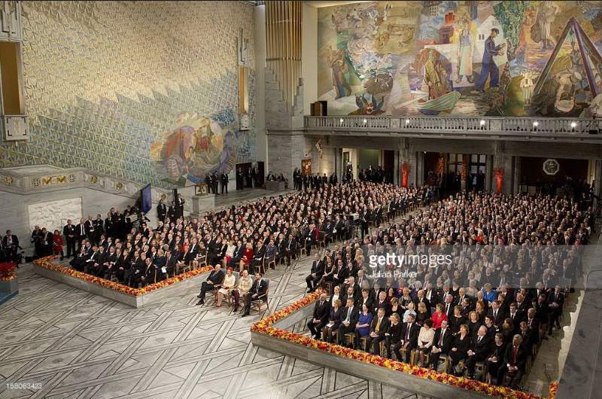
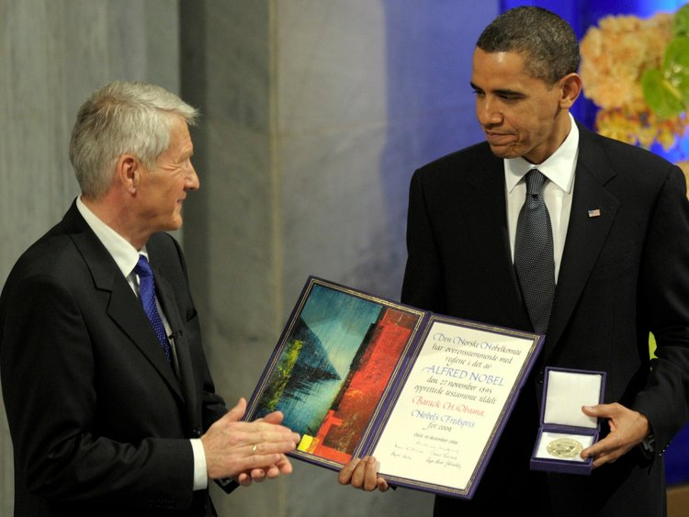
Mayor’s Reception
Address by the mayor’s office
Address by EWA
Address by Oslo Water
Strengthening of master curricula in water resources management
for the Western Balkans HEIs and stakeholders
www.swarm.ni.ac.rs

Slide 13
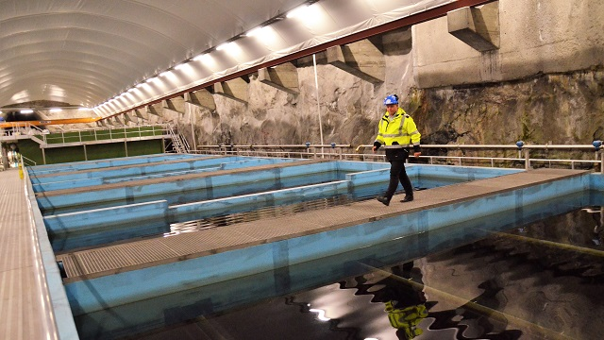
Professional tour
18 June – Excursions to storm water management solutions in Oslo and underground storm water and wastewater treatment facility

Slide 14
Objective 3
Management approaches in Norway
Role of collaboration with industry in higher education
Reflective discussion & group work

Slide 15
Schedule & Agenda
16 June | Arrivals
17 June | EWA conference and reception (in Oslo)
18 June | Excursions
19 June | At NMBU Lectures with IWSS Facilities tour Group discussion
20 June | Departure
Arrivals & Departures schedule ?
Accommodation: Option at NMBU – 50 EUR/day, private bedrooms, shared kitchen and bathroom
Transport:
16 June – If accommodation at NMBU – we can organize transfers from arrivals
17 June – in Oslo, our bus from NMBU
18 June – our bus from NMBU, locations outside Oslo
19 June – activities at NMBU, train from Oslo

Slide 16
Guests
UNI - Milan Gocić
UNI - Slaviša Tajković
UNI - Mladen Milanović
UNS - Igor Peško
UNS - Vesna Mašulović
UNSA - Emina Hadžić – accommodation at NMBU
UNSA - Suvada Jusić – accommodation at NMBU
UNMO - Marko Ćećez
UNMO - Merima Šahinagić-Isović
UPKM - Đurica Marković
UPKM - Saja Kosanović
TCASU - Predrag Ralević
UoM Goran Sekulić
UoM - Ivana Ćipranić
???
Subject preferences?
Strengthening of master curricula in water resources management
for the Western Balkans HEIs and stakeholders
www.swarm.ni.ac.rs

Slide 17
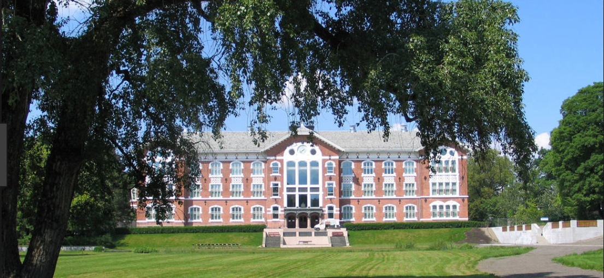
Strengthening of master curricula in water resources management
for the Western Balkans HEIs and stakeholders
www.swarm.ni.ac.rs

